Slide 1
Electrical Installations

Slide 2
Electrical Installations
To get proper lighting and to run various appliances we need electrical power.
Electrical power is distributed to consumers by single phase two wire system or three phase four wire system or three phase three wire system.
For electrical installation, selection of cables and type of wiring is the most important thing
We also need some accessories such as switches, fuses, sockets etc.

Slide 3
Electrical Installations –wires and cables
Cables are classified according to the insulation used over the conductor.
The selection of suitable cable for an installation depends on the
The nature of conditions under which cable is to be used (underground, hanging in air)
The operating voltage
The current capacity
The operating voltage determines the thickness of the insulation.
The current capacity determines the cross-sectional area or size of the conductor.

Slide 4
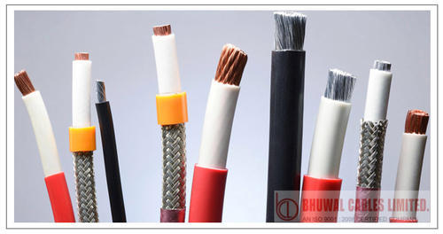
Elastomer Insulated wires and Cables
These cables are suitable for use where the combination of ambient temperature and temperature-rise due to load results in conductor temperature not exceeding 90°C under normal operation and 250°C under short-circuit conditions.
This insulation shall be so applied that it fits closely on the conductor (with or without either separator or screen) but shall not adhere to it. The insulation is applied in two or more layers.
Applications: Welding Cables, Ship wiring cables, Pressure Tight Cables and cables for submerged connection, Railways locomotives and coach wiring cables, Mining Cables.

Slide 5
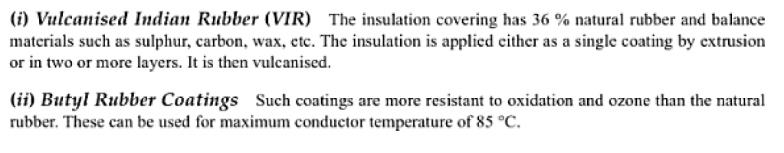
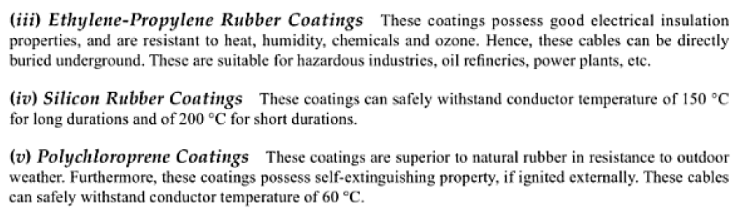
Elastomer Insulated Cables

Slide 6
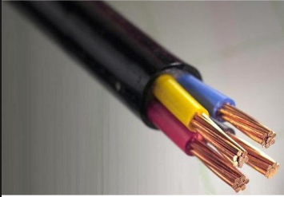
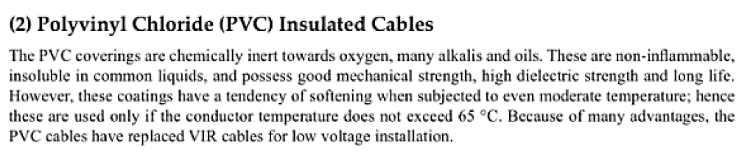
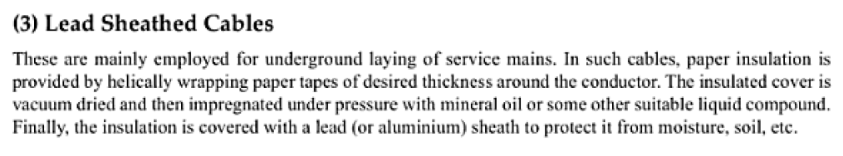
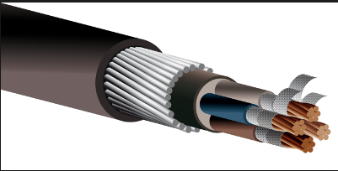
Cable types

Slide 7
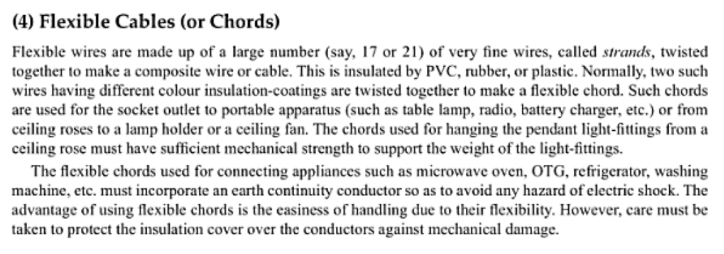
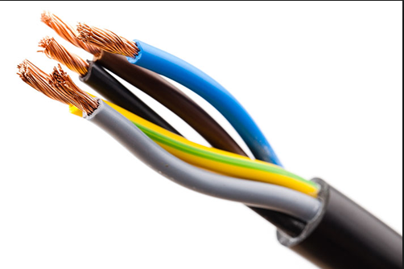
Cable types

Slide 8
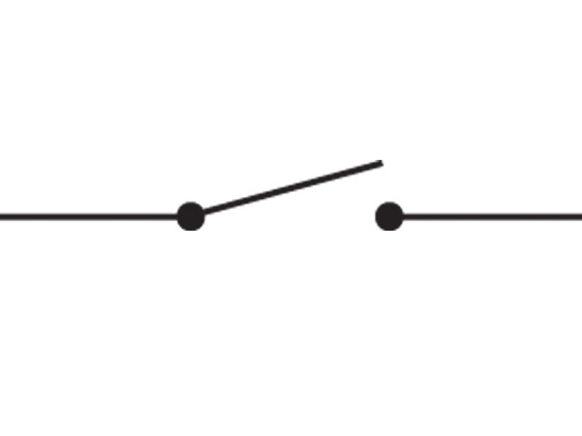
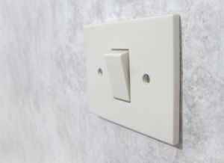
Switches
A device for making or breaking the connection in an electric circuit. Binary device – either in ‘on’ or ‘off’ state.
Different electrical loads need to be switched ON and OFF frequently. This is achieved by inserting switch.
The switches for domestic installations have standard 5 A capacity for lighting circuits (lamps, fan, mobile charger etc.) and 15 A capacity for power circuits (microwave oven, washing machine, geyser, AC etc.)

Slide 9
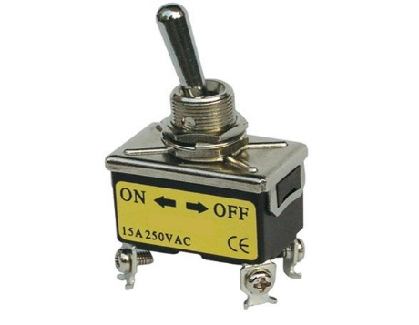
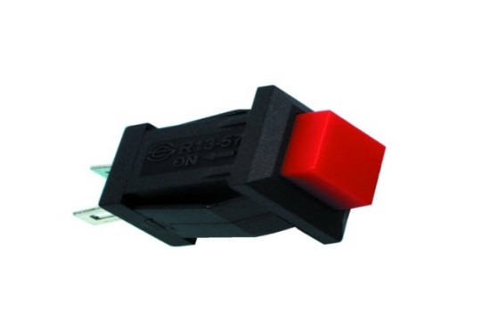
Types of switches
Single Pole Single Throw (SPST):
A simple on-off switch. It can be used to switch the power supply to a circuit. Example: Light switch.
Toggle Switches
Manually actuated by a mechanical lever, handle, or rocking mechanism. Available in many different styles and sizes, and used in countless applications. Can be designed to control large amounts of electrical current or mains voltages.
Push-to-make
Normally-open(NO) switch, which makes contact when the button is pressed and breaks when the button is released.
Push-to-break
Normally-closed(NC) switch, breaks contact when the button is pressed and makes contact when it is released.

Slide 10
Circuit breakers
An electrical circuit breaker is a switching device that can be operated manually or automatically for controlling and protecting the electrical power system.
Without a circuit breaker, there is a high risk of electrical fires and electrical shocks.
All circuit breaker systems have common features in their operation, but details vary substantially depending on the voltage class, current rating and type of the circuit breaker.

Slide 11
Different types of circuit breakers:
Based on Voltage
– Low voltage circuit breakers: These breakers are rated for use at low voltages up to 2 kV and are mainly used in small-scale industries.
– High voltage circuit breakers: These breakers are rated for use at voltages greater than 2 kV.

Slide 12
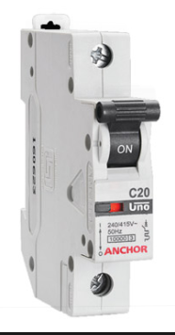
MCB (miniature circuit breaker)
MCB is an electromechanical device which guards an electrical circuit from an over current, that may effect from short circuit, overload or imperfect design.
A miniature circuit breaker automatically switches off electrical circuit during abnormal condition of the network means in over load condition as well as faulty condition.
Restoration of supply is easily possible by just switching it ON.
Protection of overload by using a bimetallic strip & short circuit protection by used solenoid.

Slide 13
Types
By Interrupting Mechanism
Air circuit breaker: This breaker uses air as an insulating and interrupting medium. The breaker is sub-classified into two types:
Low voltage circuit breaker whose value lies below 1000 V
High voltage circuit breaker whose value is 1000 V and above
Oil circuit breaker: It uses oil as an interrupting and insulating medium. These breakers are divided into two types based on the pressure and amount of oil used.
Vacuum circuit breakers: These breakers use vacuum as the interrupting medium due to its high dielectric and diffusive properties.
MCB (Miniature Circuit Breaker): The current ratings for this breaker are less than 100A and has only one over-current protection built within it. The trip settings are not adjustable in this circuit.
MCCB (Moulded Case Circuit Breakers): Current ratings for these breakers are higher than 1000A. The trip settings of the breaker can be adjusted easily.

Slide 14
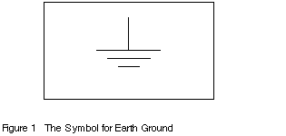
Earthing
In electrical engineering, earthing or grounding means literally to make an electrical connection between the ground and a metal part. In practice this is usually done by connecting to the ground pin of an electrical socket, which is itself connected to ground.
It is the most important part of an electrical installation, as it provides safety.
An electrical equipment is said to be earthed if its outer frame and other parts not carrying current are connected to earth so as to attain nearly zero potential.

Slide 15
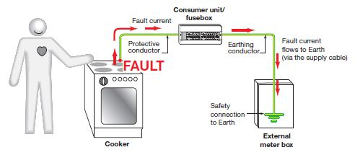
EARTHING WORKING
The basic idea of a safety from electrical disaster is same everywhere. The case (chassis) of the equipment is connected to an earth pin on the mains outlet. This is then connected through the house wiring and switchboard to an electrically solid earth point, which is called EARTHING or GROUNDING.
If a fault develops within the equipment that causes the active (live) conductor to come into contact with the chassis, the fault current will flow to earth. This protects the user from electric shock, bypassing the dangerous current directly to earth, rather than through the body of the person.

Slide 16
Main Objectives of Earthing systems
Provide an alternative path for the fault current to flow so that it will not endanger the user
Ensure that all exposed conductive parts do not reach a dangerous potential
Maintain the voltage at any part of an electrical system at a known value so as to prevent over current or excessive voltage on the appliances or equipment.
To provide protection against static electricity.

Slide 17
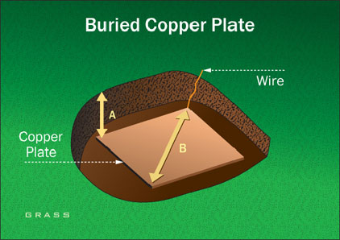
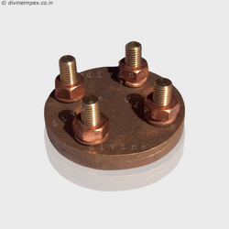
Methods of earthing
Plate type earthing
Generally for plate type earthing normal Practice is to use
Cast iron plate of size 600 mm x600 mm x12 mm. OR
Galvanized iron plate of size 600 mm x600 mm x6 mm. OR
Copper plate of size 600 mm * 600 mm * 3.15 mm
Plate burred at the depth of 8 feet in the vertical position and GI strip of size 50 mmx6 mm bolted with the plate is brought up to the ground level.
These types of earth pit are generally filled with alternate layer of charcoal & salt up to 4 feet from the bottom of the pit.

Slide 18
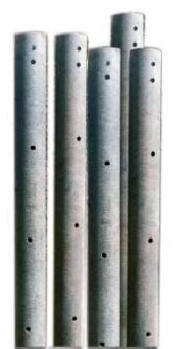
Methods of earthing
Pipe type earthing
For Pipe type earthing normal practice is to use GI pipe of 38 mm diameter, 6 feet long, having 6 numbers of holes at lower end for the connection of earth wires are inserted in ground. These types of earth pit are generally filled with alternate layer of charcoal & salt.

